Slide 1
KARST LANDFORMS BY
PROF. ROBINA KOUSER
ASSISTANT PROFESSOR
IN
GEOGRAPHY

Slide 2
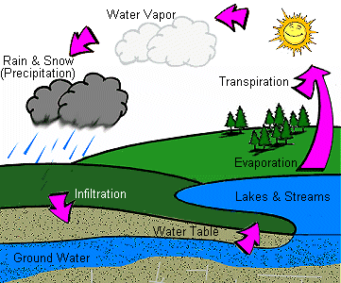
The Water Cycle

Slide 3
Limestone & Carbonation
Limestone is permeable
Rain takes in carbon dioxide as it passes through the atmosphere
Carbon dioxide (CO2) dissolves in rainwater (H2O)
Forms weak carbonic acid (H2CO3)
The carbonic acid reacts with the calcium carbonate (CaCO3) in the limestone
This forms calcium bicarbonate (Ca(HCO3)2), which is soluble in water
This solution percolates through rock
It removes the calcium carbonate
Fissures in rock become enlarged
Underground drainage system develops

Slide 4
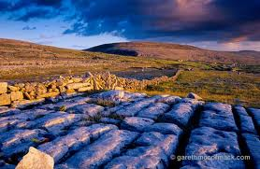
Surface Landforms
Karst Landscapes

Slide 5
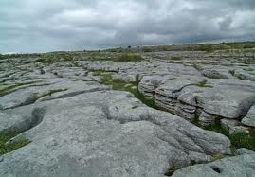
Limestone pavement
Exposed area of limestone
Rugged and bare landscape with flat areas of rock surface

Slide 6
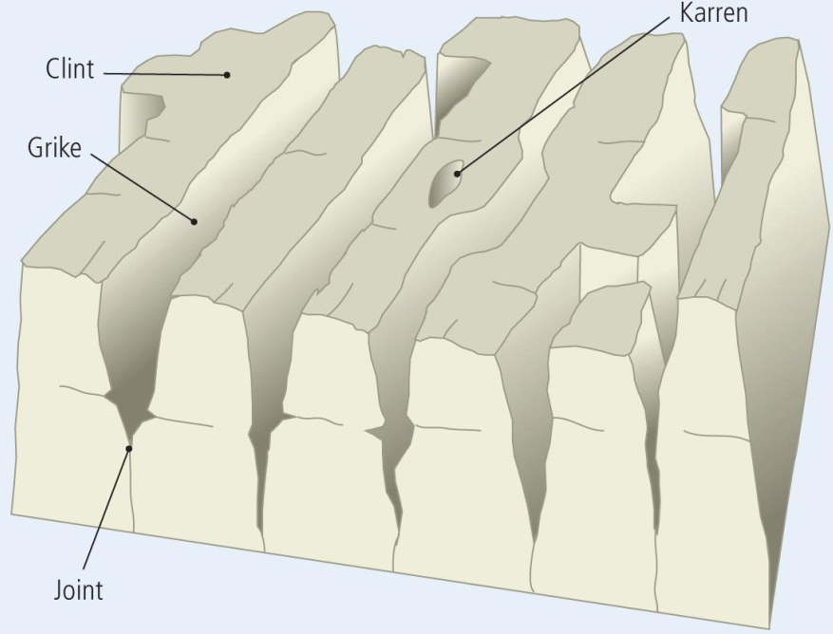
CLINT GRIKE KARREN AND JOINT

Slide 7
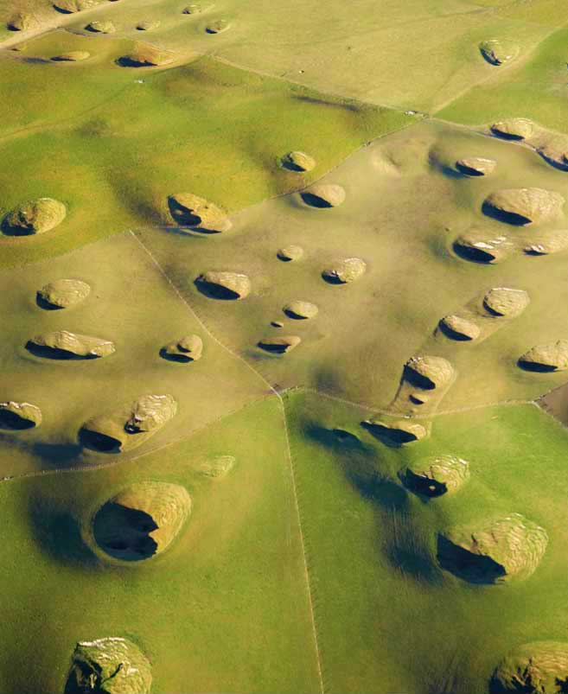
2.
Dry valley = remains of river valley downstream from sinkhole
River of resurgence = where river reappears at the surface

Slide 8
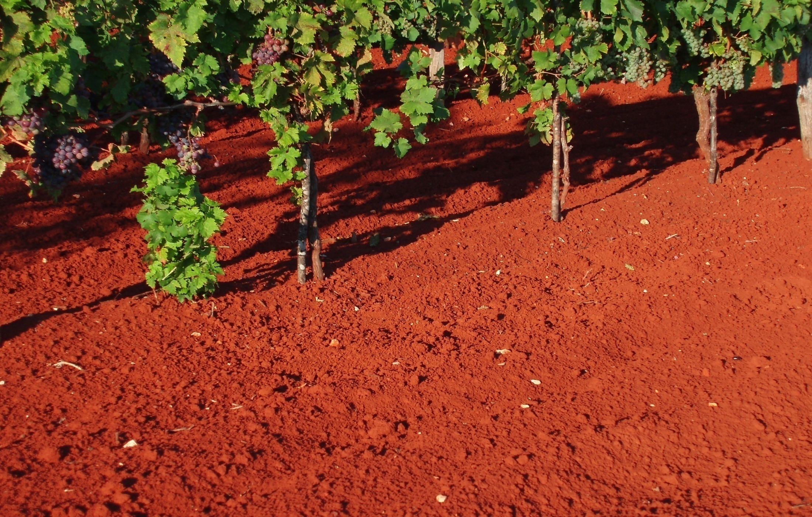
Terra rossa

Slide 9
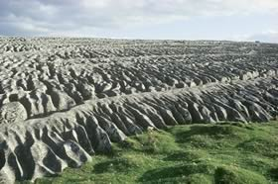
lapies

Slide 10
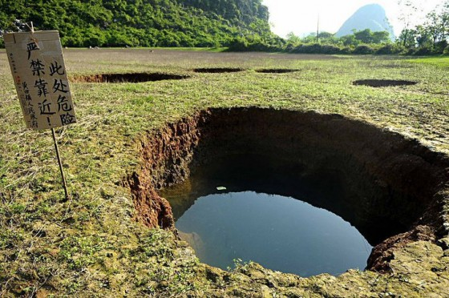
SINK HOLE

Slide 11
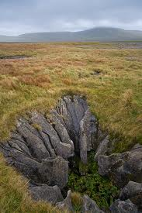
Swallow Holes
A river disappears underground in a limestone region

Slide 12
Formation of Swallow Holes
River reaches an area of permeable rock
Disappears down through grikes
Grikes made bigger by solution (carbonation)
Forms swallow hole (sluggas/sinkholes)
e.g. Poll na gColm in the Burren, Co. Clare

Slide 13
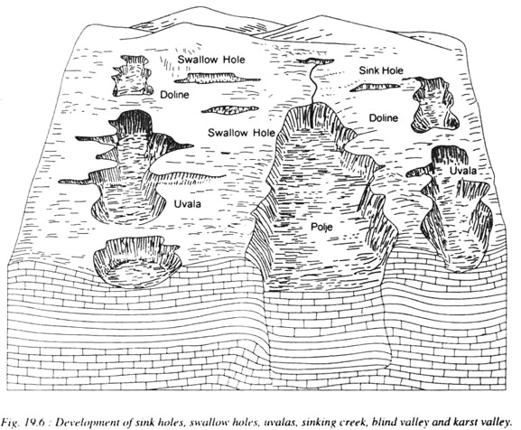
SINK HOLE SWALLOW HOLE UVALA AND POLJE

Slide 14
Underground Landforms
Karst Landscape

Slide 15
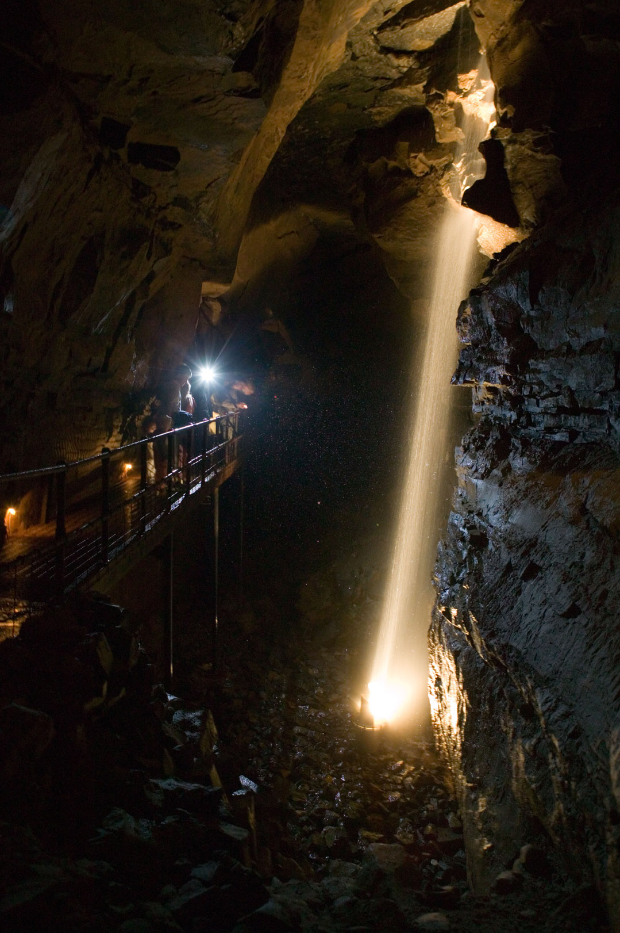
Caves
Swallow holes – river disappears underground
Carbonation – passages form large caverns
River erodes the rock of the cave by abrasion and hydraulic action
Carbonation and solution dissolve permeable rock (limestone)
Cave develops at or below zone of saturation
e.g. Ailwee Cave, the Burren, Co. Clare; Dunmore caves, Kilkenny
Notes:
Zone of Saturation is the soil or rock below the water table, all spaces there are permanently filled with water

Slide 16
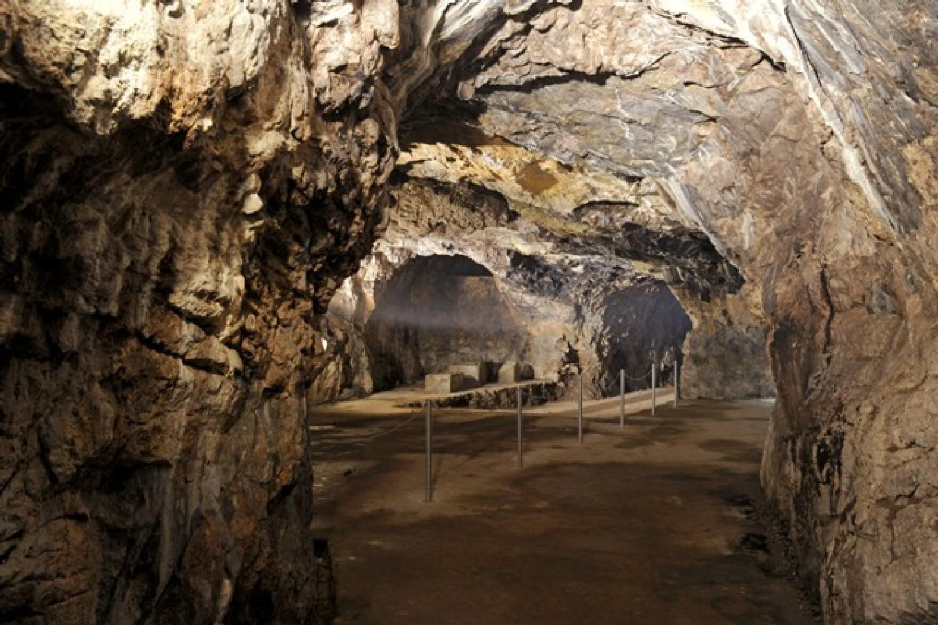

Slide 17
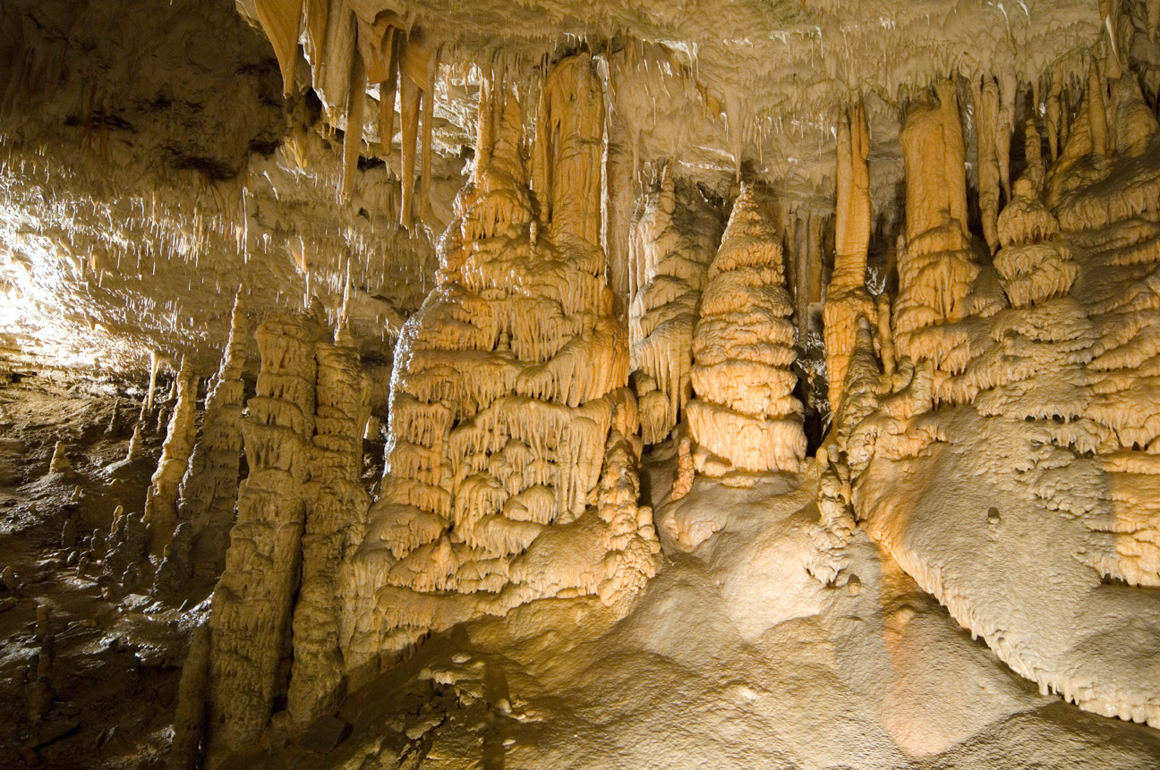
Dripstone Features
Stalactites
Drops of water containing dissolved limestone seep down through cracks/fissures in the cave roof
Drops of water lose carbon dioxide and deposit calcite
Over time deposition of calcite forms the stalactites hanging down from the roof of the cave
Stalactites are hollow mineral tubes, like drinking straws
They are very thin and fragile
Stalagmites
Water droplets fall to the cave floor
Drops of water lose carbon dioxide and deposit calcite
Over time deposition of calcite form the stalagmites growing upward from the cave floor form directly below stalactites
Stalagmites are thicker than the stalactites

Slide 18
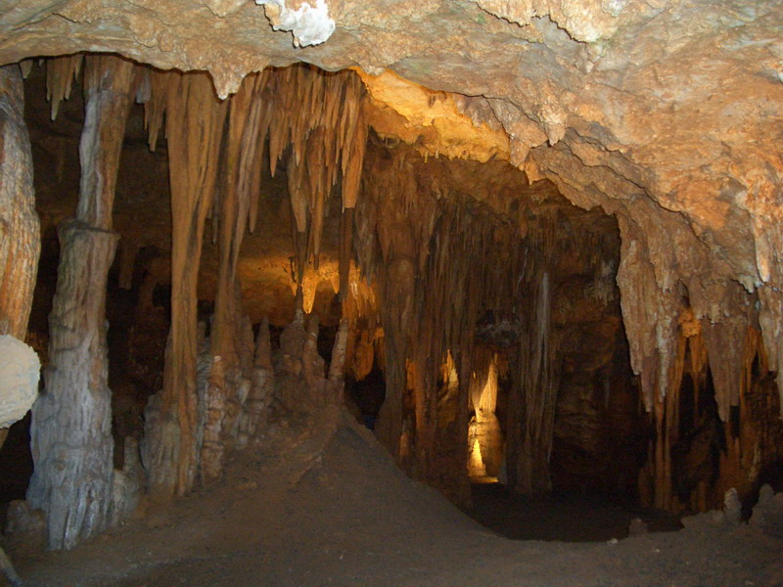

Slide 19
Pillars
Stalactites and stalagmites grow towards each other
Eventually join to form a pillar or column
Curtains
Rainwater drips from a long crack in a cave roof forms a continuous strip of calcite

Slide 20
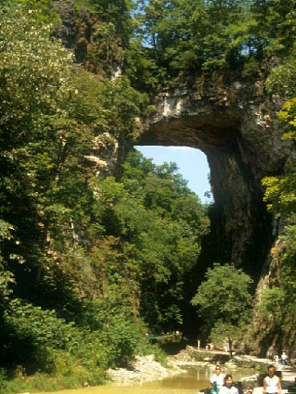
NATURAL BRIDGE

Slide 21
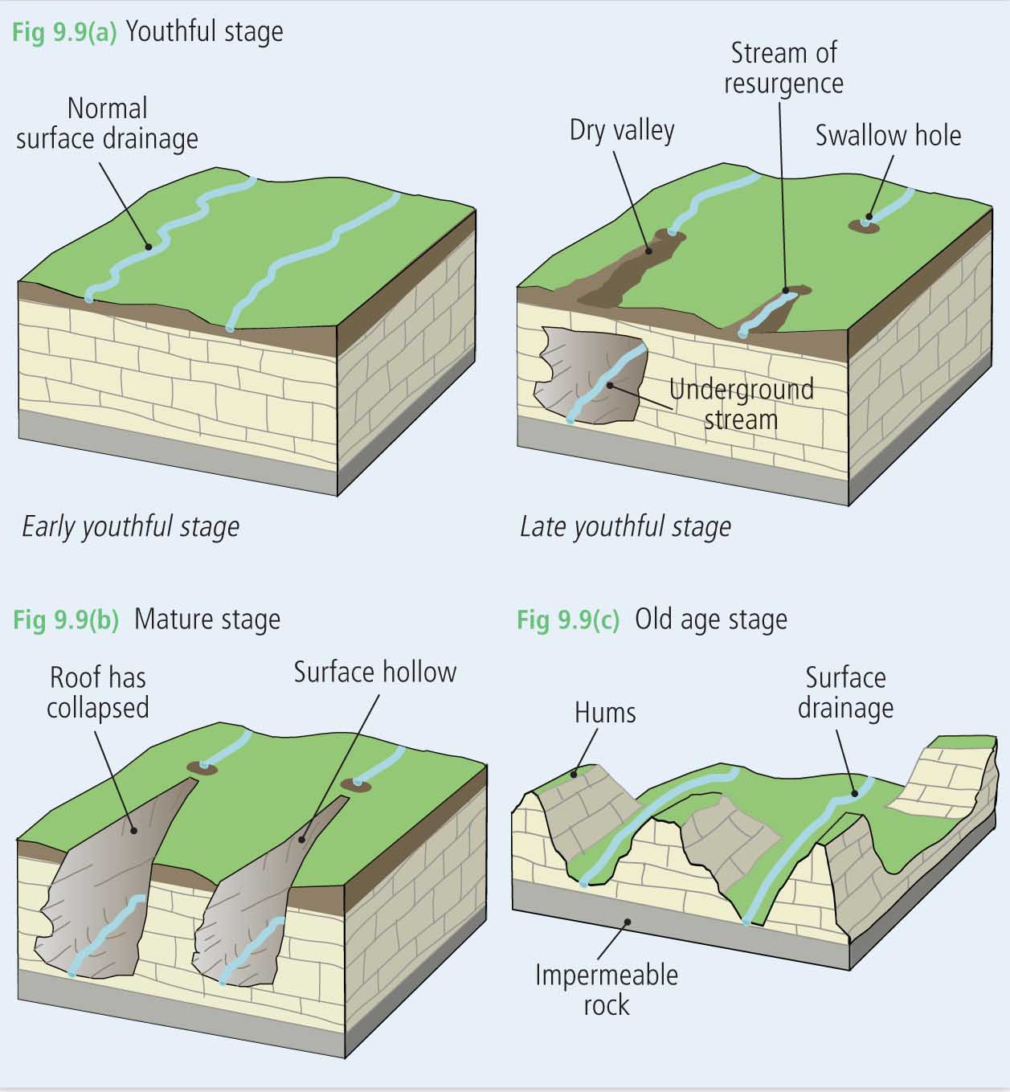
Cycle of Erosion in a Karst Topography
Three stages:
Youthful
Mature
Old age

Slide 22
Youthful stage
Rivers flowing on the surface
Erosion of impermeable rock
Then erosion of permeable rock (limestone)
Chemical weathering (carbonation)
Formation of swallow holes

Slide 23
Mature stage
Dry valleys on the surface
Swallow holes

Slide 24
Old age stage
Weathering
Removal of limestone
Older more resistant rock left prominent – hums
Rivers once again flow over the surface
Notes:
Hums- Rocks that stand out on the landscape

Slide 25
THANKS

